Slide 1
Session Topic: EVENT MANAGER
Lunch and Learn
Program Administrators

Slide 2
AGENDA
01
Event Templates/opt- Out Feature
02
Manually Add Learners to Events
03
Evaluation Forms
04
Aggregate Evaluations
05
Attendance Reporting

Slide 3
EVENT TEMPLATES
There are 4 evaluation templates available:
1. Case Based Learning/Problem Based Learning
2. Journal Club
3. Lecture
4. No Evaluations
To add a new template, hover over the template name and click the ‘+’ key

Slide 4
EVENT TEMPLATES
Event Template tab outlines details that will carry into ALL events using this template.
The ‘type’ will dictate the evalaution and the owner will dictate who receives reporting on this event.

Slide 5
EVENT TEMPLATES
NOTE: evaluation of an event has been disabled as there is no longer an event specific evaluation.
Evalaution were combined into one evaluation due to learners not completing two separate evaluations per event (presenter and event)
If you have this selected on your template, nothing will generate

Slide 6
EVENT TEMPLATES
The Registration Settings tab is the most important piece of the event manager as it defines the participants and registration process of events.
1. Define WHO you would like to attend the event (both trainees and supervisors can be added)
2. Define Registration Details:
Do you want to auto-register your participants?
Do you want to auto set your learners to present on the day of the event?
Do you want your learners to be able to Opt-Out?
*BEST PRACTICE – all turned ON*

Slide 7
EVENT TEMPLATES
WHY SHOULD I AUTO-SET ATTENDANCE TO PRESENT?
This means that your learners will receive a presenter evalaution to complete the day of the event. If you don’t have their status set, they will NOT receive an evaluation until it is manually updated.
Setting them to ‘present’ ensures they receive and evalaution. You have 14 days to go into the event before it expires and updated them to absent which will purge the evaluation from their dashboard.

Slide 8
OPT-OUT FEATURE
The Opt-Out feature gives learners the opportunity to opt-out of a future event that they know they will be able to attend.
You can set the status to Absent or Exempted depending on how you would like to report on it

Slide 9
OPT-OUT OF AN EVENT – ADMIN VIEW
If a learner opts out, you will be able to see it in the registration settings
The attendance status will automatically update based on the registration settings

Slide 10
OPT-OUT OF AN EVENT – ADMIN VIEW
Hover over the information icon to view the details left by the learner
NOTE: There are no email notifications generated if a learner opts out of an event
You will be able to report on opt-outs through attendance reports.

Slide 11
WHAT DOES IT LOOK LIKE FROM A LEARNER’S VIEW?
Learners will double click on an event and choose “Opt-Out” to opt-out of attending:

Slide 12
WHAT DOES IT LOOK LIKE FROM A LEARNER’S VIEW?
Learners will specific their reasons for and leave any additional comments:

Slide 13
WHAT DOES IT LOOK LIKE FROM A LEARNER’S VIEW?
After submitting, a confirmation will appear that they have successfully opted out of the event:

Slide 14
WHAT DOES IT LOOK LIKE FROM A LEARNER’S VIEW?
Also, iCal Sync from learner view:

Slide 15
AGENDA
01
Event Templates/opt- Out Feature
02
Manually Add Learners to Events
03
Evaluation Forms
04
Aggregate Evaluations
05
Attendance Reporting

Slide 16
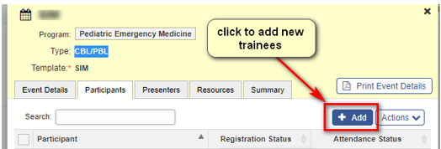
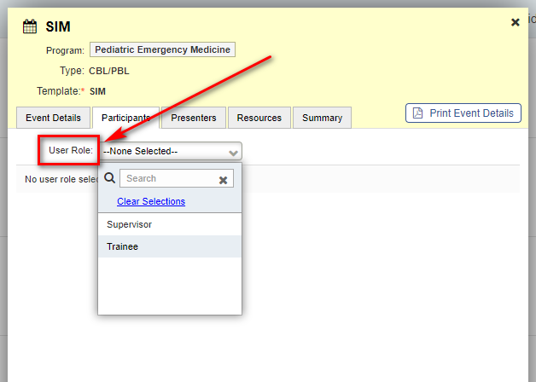
MANUALLY ADDING LEARNERS TO EVENTS
Learners can be manually added to events in addition to those that are auto-registered (ex. visiting electives, off service learners)
Double click on the event that you would like to add trainees to.
Click on the “add” button:
Click on the User Role to choose the participants
You can add both trainees & supervisors as participants for an event

Slide 17
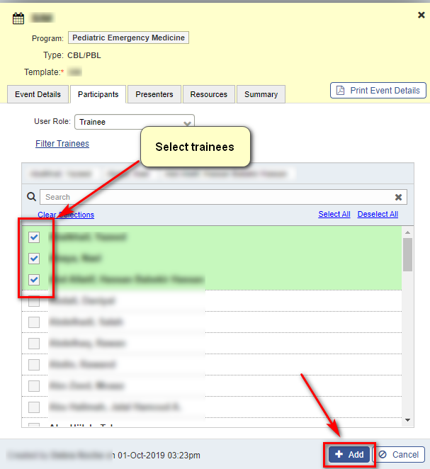
MANUALLY ADDING LEARNERS TO EVENTS
Select Trainees and click Add
NOTE: You will need to clear any auto-filters set from your template in order to see all learners.

Slide 18
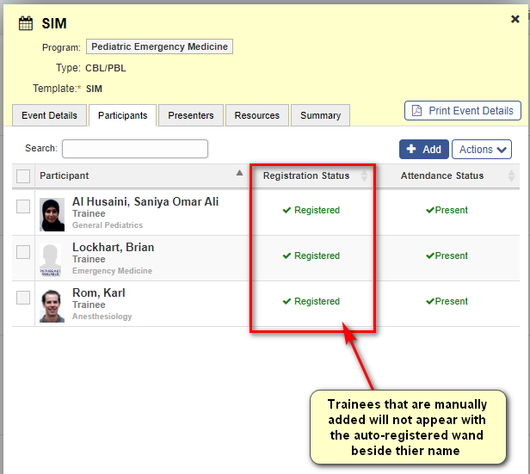
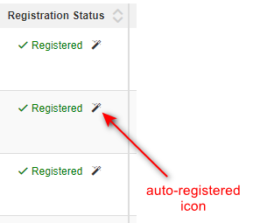
MANUALLY ADDING LEARNERS TO EVENTS
All trainees selected will appear as registered on the participants tab.
They will not have the auto-registered wand beside their name.

Slide 19
AGENDA
01
Event Templates/opt- Out Feature
02
Manually Add Learners to Events
03
Evaluation Forms
04
Aggregate Evaluations
05
Attendance Reporting

Slide 20
EVENT EVALUATION FORMS
3 Event Evaluations
Journal Club
Lecture
Problem Based Learning
All include teacher-based questions and event-based questions
3 common comment fields

Slide 21
EVENT EVALUATION FORMS
*If there is no presenter entered into an event,
NO EVALUATIONS WILL GENERATE*

Slide 22
AGENDA
01
Event Templates/opt- Out Feature
02
Manually Add Learners to Events
03
Evaluation Forms
04
Aggregate Evaluations
05
Attendance Reporting

Slide 23
AGGREGATE EVENT EVALUATIONS
OLAP reporting was used for event reporting up to December 2020.
Aggregate reporting is available in the Event Manager for all events taking place after January 1, 2021.
Aggregate reports are available PER EVENT
The confidentiality minimum of 3 must be met for the aggregate to be available
The aggregate report will become available once the event has expired (event expiry = 14 days after the date of the event)

Slide 24
AGGREGATE EVENT EVALUATIONS
Click on the ‘Summary’ tab and select the magnifying glass beside the percentage completed:

Slide 25
AGGREGATE EVENT EVALUATIONS

Slide 26
AGGREGATE EVENT EVALUATIONS

Slide 27
AGENDA
01
Event Templates/opt- Out Feature
02
Manually Add Learners to Events
03
Evaluation Forms
04
Aggregate Evaluations
05
Attendance Reporting

Slide 28
EVENT ATTENDANCE REPORTING
Attendance reporting can now be pulled through MedSIS
There is a new button on the left-hand side called “Exports”

Slide 29
EVENT ATTENDANCE REPORTING
There currently is no restriction on security roles, so you will see exports all programs.
If you would like an attendance report created for your program, please submit a JIRA ticket

Slide 30
EVENT ATTENDANCE REPORTING
Why do I need to submit a JIRA ticket ?
1. The conditions are difficult to create
2. I can help you set up the exact type of report you are looking for

Slide 31
EVENT ATTENDANCE REPORTING

Slide 32
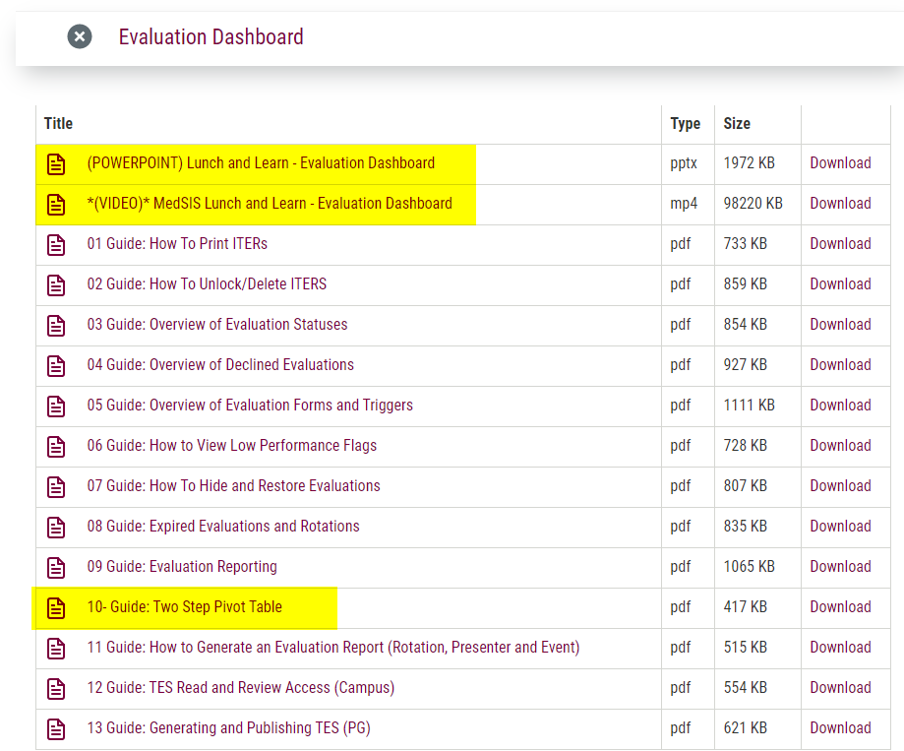
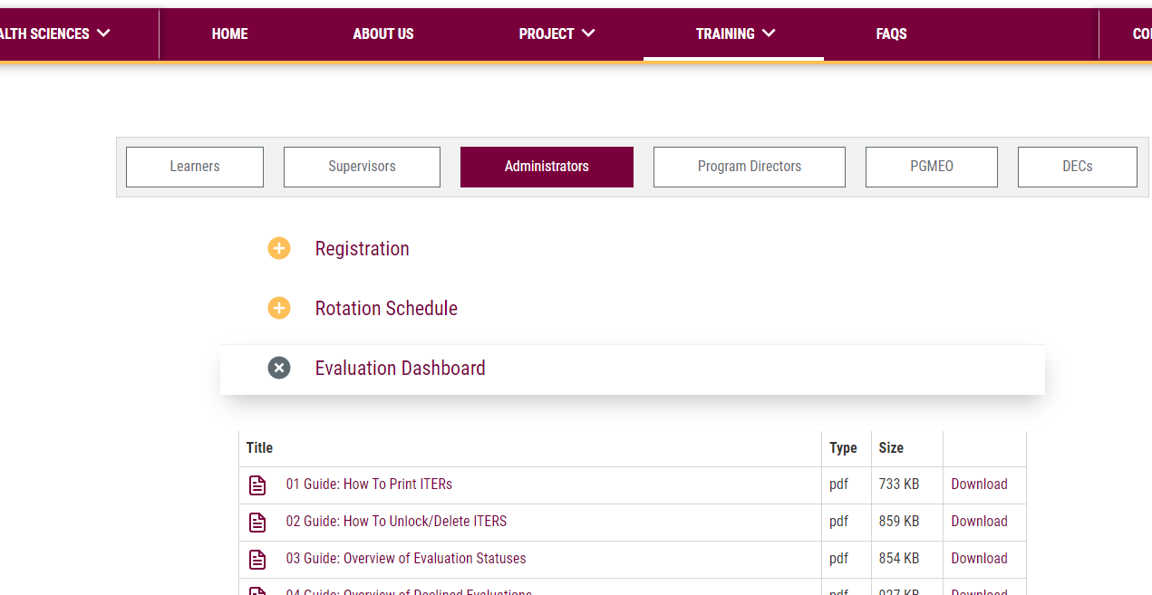
MEDSIS WEBSITE
https://healthsci.mcmaster.ca/medsis/training/pgme
You can find this information as well as more resources on our website under:
TRAINING → PGME → ADMINISTRATORS
JIRA TICKETING SYSTEM
To submit a ticket, please visit medsishelp.mcmaster.ca
User Guide: How to Submit a Ticket

