Slide 1
Session Topic: Procedure Log
Lunch and Learn
Program Administrators

Slide 2
AGENDA
01
Procedure Log: Summary Dashboards
02
Procedure Log: Dashboard
03
Manually add new procedures
04
Procedure Log:
Learner View

Slide 3
PROCEDURE LOG OVERVIEW
The Procedure Log replaced the Activity Log last year
The Procedure Log captures procedures completed by learners throughout rotations
The Procedure Log displays in Learner Curriculum for CBME programs so they can be reviewed by Academic Coaches for competency committee review
Programs can choose to have their supervisors sign off enabled for their procedures or turned off for forms.
There is the ability to enable procedures to be available to any other programs.
Ex. Vascular Surgery can access Plastic Surgery's procedures so that learners can complete them while on that rotation.
Procedure evaluations do not expire

Slide 4
SUMMARY DASHBOARD
Summary dashboard outlines procedures completed PER LEARNER
The procedure summary will display the learner’s name, administrative program, supervisor assessed procedures, self assessed procedures, and total number of logged procedures.
Includes all academic years (entirety of training)
Can filter per academic year

Slide 5
SUMMARY DASHBOARD
Summary dashboard export = exports all columns into excel report

Slide 6
DETAILED DASHBOARD
Details dashboard outlines a details summary of procedures completed PER PROCEDURE
Each procedure will appear on a separate row per learner with a count of how many procedures have been logged.

Slide 7
DETAILED DASHBOARD
Detailed summary dashboard export = exports all columns into excel report

Slide 8
AGENDA
01
Procedure Log: Summary Dashboards
02
Procedure Log: Dashboard
03
Manually add new procedures
04
Procedure Log:
Learner View

Slide 9
PROCEDURE MAIN DASHBOARD
Detailed dashboard PER PROCEDURE
Every procedure submitted by a learner will be displayed here with all details logged.

Slide 10
PROCEDURE MAIN DASHBOARD
Ability to filter on learner name, specific procedure, supervisor, training session, date range, training level, program, etc).

Slide 11
PROCEDURE MAIN DASHBOARD
Two reports available on this dashboard:
Export Procedure Summary:
Includes all columns within this dashboard

Slide 12
PROCEDURE MAIN DASHBOARD
Export Procedure Form Details:
The report will export details captured in the procedure form.

Slide 13
PROCEDURE MAIN DASHBOARD
Export Procedure Form Details:

Slide 14
AGENDA
01
Procedure Log: Summary Dashboards
02
Procedure Log: Dashboard
03
Manually add new procedures
04
Procedure Log:
Learner View

Slide 15
PROCEDURE LOOKUP TABLES
There are two look up tables under the Procedure Log:
Category
Procedure
A category must exist before a new procedure can be added within it

Slide 16
PROCEDURE LOOKUP TABLES
There are two look up tables under the Procedure Log:
Category
Procedure
A category must exist before a new procedure can be added within it
Click on “Add New” to create a new category

Slide 17
PROCEDURE LOOKUP TABLES
Programs can share procedures (external programs)
Edit a procedure by clicking on the procedure name in blue
Click on “Add New” to create a new procedure

Slide 18
PROCEDURE LOOKUP TABLES
PROCEDURE – name of the procedure
PROGRAM – program that the procedure belongs to
EXTERNAL PROGRAMS– programs that may have learners completing your programs procedures (ex. General Surgery learners complete Plastic Surgery’s procedures when they are on a plastic surgery rotation).
CATEGORY – category that the procedure falls under
FORM – choose the default form for your program
EFFECTIVE DATE – date that you would like the procedure to be available on
EXPIRY DATE – date that you want the activity to expire. (Default is June 30, 2030).
SUPERVISOR SIGN OFF – choose “yes” if supervisor sign off. Choose “no” if procedure will never require supervisor sign off.
NOTE: If you select “no”, this means that if a learner enters supervisor’s name, the procedure will still be self reported with the name tracked on exports.

Slide 19
AGENDA
01
Procedure Log: Summary Dashboards
02
Procedure Log: Dashboard
03
Manually add new procedures
04
Procedure Log:
Learner View

Slide 20
PROCEDURE – LEARNER VIEW
TWO options to access the procedure log
1. Click on the menu item called ‘Procedure Log’ and select “Log A Procedure’:

Slide 21
PROCEDURE – LEARNER VIEW
2. Click the “Log A Procedure” button from the main dashboard:

Slide 22
PROCEDURE – LEARNER VIEW
Learners will complete the following details when logging a procedure:
The ‘rotation’ field will default to their current rotation. If they have multiple rotations in a block, they will pick the rotation. Previous rotations will also be available in the drop down
The ‘category’ field is dynamic where once a category is chosen, the procedures within that category will appear
The ‘Eval form’ will default to the form used for their program.
The supervisor drop down will include all supervisors from the supervisor registry. Learners can add a new supervisor if they are not listed.

Slide 23
Questions?

Slide 24
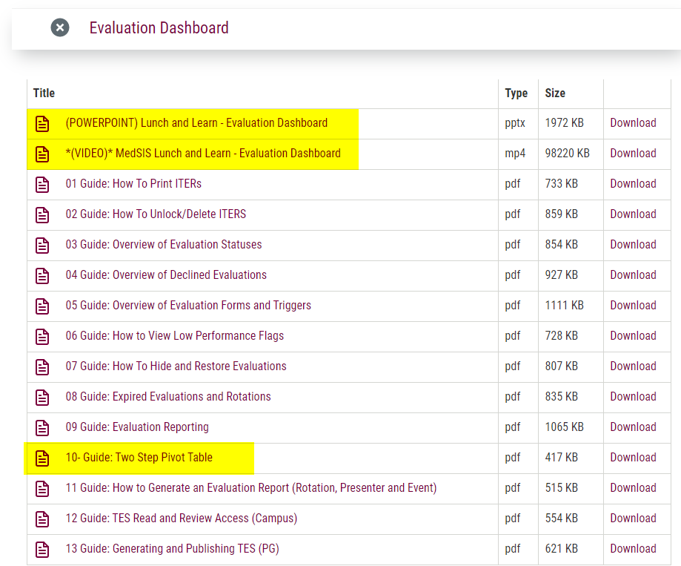
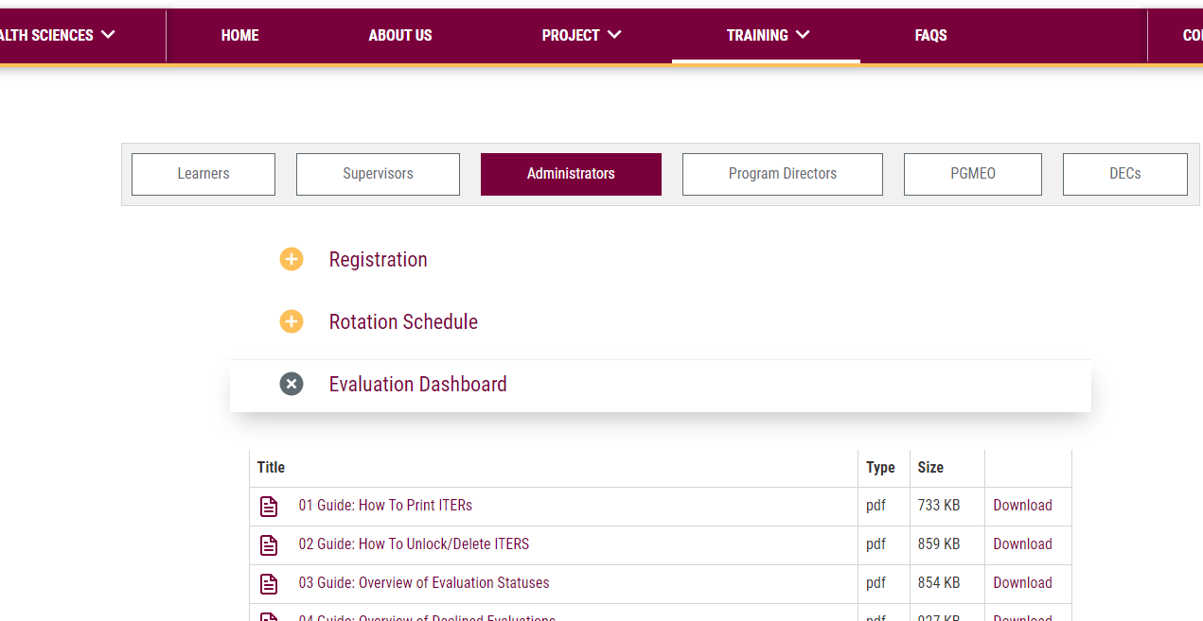
MEDSIS WEBSITE
https://healthsci.mcmaster.ca/medsis/training/pgme
You can find this information as well as more resources on our website under:
TRAINING → PGME → ADMINISTRATORS
JIRA TICKETING SYSTEM
To submit a ticket, please visit medsishelp.mcmaster.ca
User Guide: How to Submit a Ticket

