Slide 1
Session Topic: ROTATION SCHEDULE
Lunch and Learn
Program Administrators
Program Directors

Slide 2
AGENDA
01
Entering Rotations
02
Incomplete Rotations
03
Rotation Gaps
04
Exports
05
Lookup Tables
06
MTD Rotation Export

Slide 3
ROTATION SCHEDULE
MedSIS Registration module feeds Rotation Schedule
Learners will appear in your rotation schedule based on their training line
The rotation schedule will open for 2022-2023 at the beginning of March to begin entering your learner’s schedules.
Postgrad will create the PGY 1 schedule and send you an excel sheet with the rotations. You are responsible for entering these rotations into the rotation schedule.
NOTE: CaRMS match is in mid April, so you will not receive the schedule until after that.
(Icons and Colors Overview)

Slide 4
PUBLISHING ROTATIONS
All rotations require publishing. Until rotations are published, the learners cannot see them in their rotation schedule.
Rotations auto-publish the first day of the rotation.
You are responsible for publishing all rotations for your program. That INCLUDES off service learners coming through your program.
Publishing these rotations is confirmation that you are aware that they are coming through your program
Ex. ICU rotation owned by critical care needs to publish this rotation for GIM learner
GIM rotation view:
Critical Care rotation view:

Slide 5
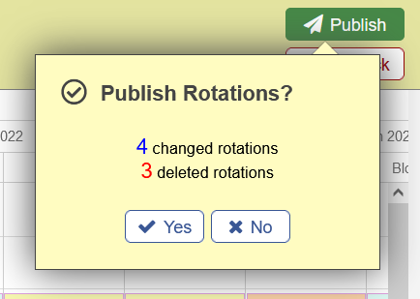
PUBLISHING ROTATIONS
Two options to publish rotations:
1. Right Click Publish
Best practice throughout academic year
2. Bulk Publish
Best used before July 1 each year to plan/confirm learner’s schedules before publishing so they can view

Slide 6
PUBLISHING ROTATIONS
What are these?
Rotations that have been deleted, but not yet published
You must right click and publish these rotations or else the system will send out evaluations for them.

Slide 7
ADDING SUPERVISORS
Supervisors are added into rotations by the program that OWNS the rotation.
Using our last example, the GIM learner going to Critical Care rotation. Critical care publishes the rotation AND enters the supervisor.

Slide 8
ADDING SUPERVISORS
The category you choose for your supervisors dictates that evaluations that will generate for your rotations.

Slide 9
VISITING ELECTIVES
Visiting elective learners will appear in your rotation schedule if they are doing their elective in your program.
You can filter visiting electives out of your rotation schedule using the filter option called ‘Trainee Type’ → ‘Trainee’
Example of a visiting elective:

Slide 10
AGENDA
01
Entering Rotations
02
Incomplete Rotations
03
Rotation Gaps
04
Exports
05
Lookup Tables
06
MTD Rotation Export

Slide 11
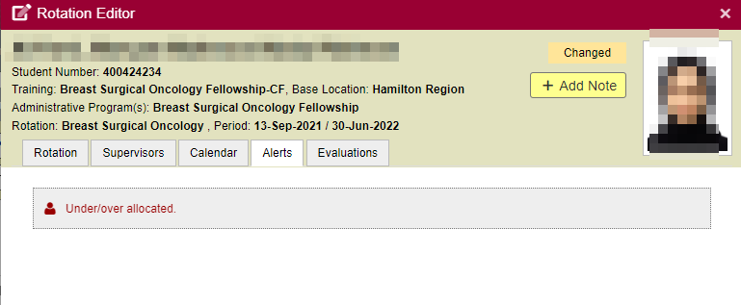
INCOMPELTE ROTATIONS
Click on the alert to view the incomplete rotations:
The alerts tab will indicate why the rotation is incomplete:

Slide 12
INCOMPELTE ROTATIONS
A rotation that is within 30 days of starting and has any of the following items missing:
Trainee Program
Rotation Name
Service
Format
Primary Location
Start/End Date
Once all incomplete rotations are “complete”, the alert at the top of the rotation schedule will disappear.
GOAL - all rotations are entered and complete BEFORE their start date in order to have the evaluations triggered
Incomplete rotations = no RTO requests, no preceptor payments, no evaluations

Slide 13
AGENDA
01
Entering Rotations
02
Incomplete Rotations
03
Rotation Gaps
04
Exports
05
Lookup Tables
06
MTD Rotation Export

Slide 14
ROTATION GAPS
You may have entered a rotation and left as little as a 1-day gap between the rotations.
This will affect MTD as every day must be accounted for!
To check for gaps, use the filter called “Alert Type” → “Training not fully covered by rotations”

Slide 15
ROTATION GAPS
Best practice to check this frequently to ensure all days of your learner’s rotations have been entered.
If the dates you entered are correct and a leave date is incorrect, please reach out to the PG Office so they can update accordingly.

Slide 16
AGENDA
01
Entering Rotations
02
Incomplete Rotations
03
Rotation Gaps
04
Exports
05
Lookup Tables
06
MTD Rotation Export

Slide 17
ROTATION EXPORTS
There are two rotation exports available in the rotation schedule
They are located within the 3 dotted icon on the right-hand side of the dashboard.

Slide 18
ROTATION EXPORTS
Export 1 – Rotation Summary
This export will give you the view of the rotation schedule in excel
Useful for a visual display to keep on your desk/use to make edits/plan out rotation schedule prior to entering into MedSIS

Slide 19
ROTATION EXPORTS
Export 2 – Rotation Details
This export will give you all the details of the rotation and learner into excel
Ex 1
Ex 2.

Slide 20
AGENDA
01
Entering Rotations
02
Incomplete Rotations
03
Rotation Gaps
04
Exports
05
Lookup Tables
06
MTD Rotation Export

Slide 21
ROTATION LOOK UP TABLES
There is an additional tab in the rotation schedule called the “Look Up Tables”
This will display ALL rotations that your program has access to (both internal and external).

Slide 22
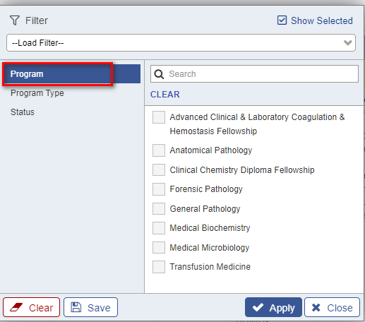
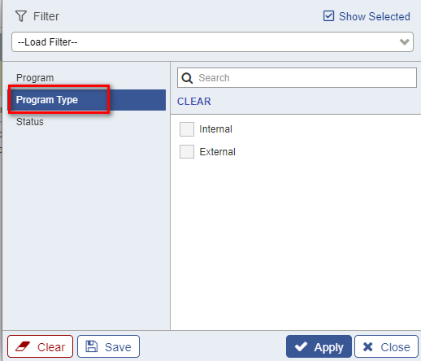
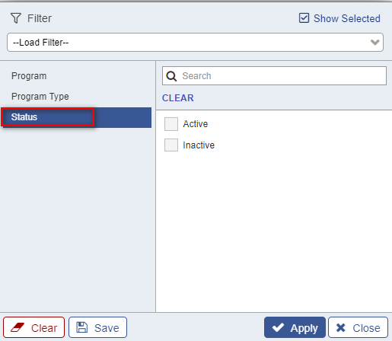
ROTATION LOOK UP TABLES
Click on the 3 dotted icon to filter the dashboard
3 Filter Options:
1. Program
2. Program Type
3. Status

Slide 23
ROTATION LOOK UP TABLES
Click on the name of a rotation to view the rotation details
NOTE: There is a tab called ‘Evaluations’. This will soon display the workflow(s) and ITERs mapped to each rotation. You will be able to see the ITER mapped and retrieve a blank version of the form:

Slide 24
AGENDA
01
Entering Rotations
02
Incomplete Rotations
03
Rotation Gaps
04
Exports
05
Lookup Tables
06
MTD Rotation Export

Slide 25
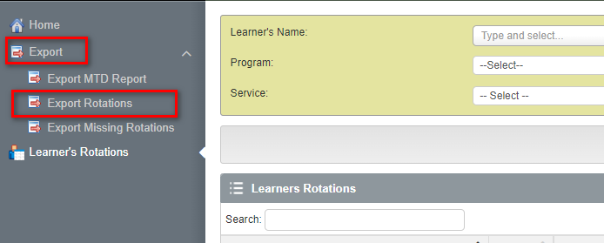
MTD ROTATION EXPORT
Programs have requested reports on their learner’s rotations completed throughout their entire training at McMaster.
This report can be found in the MTD module

Slide 26
MTD ROTATION EXPORT
Choose the following fields:
Learner’s Name
Program
Start Date/End Date

Slide 27
MTD ROTATION EXPORT
The rotation details will be exported into excel:

Slide 28
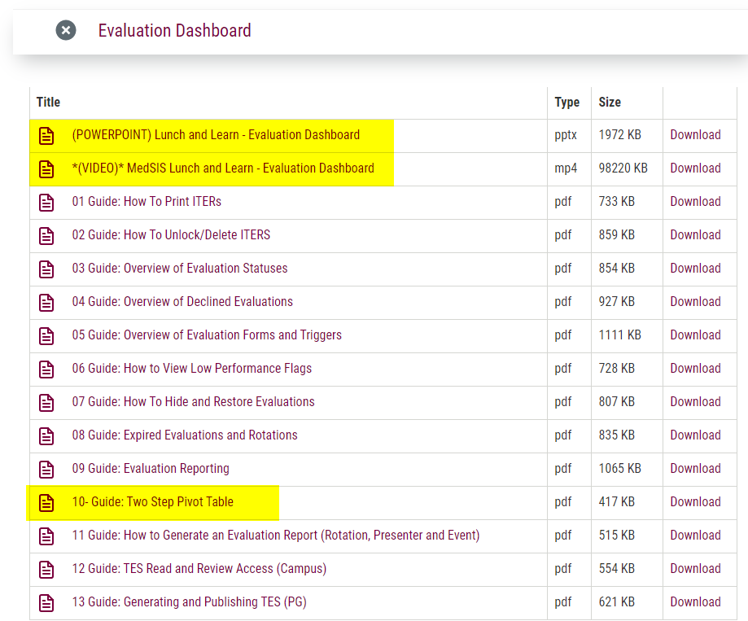
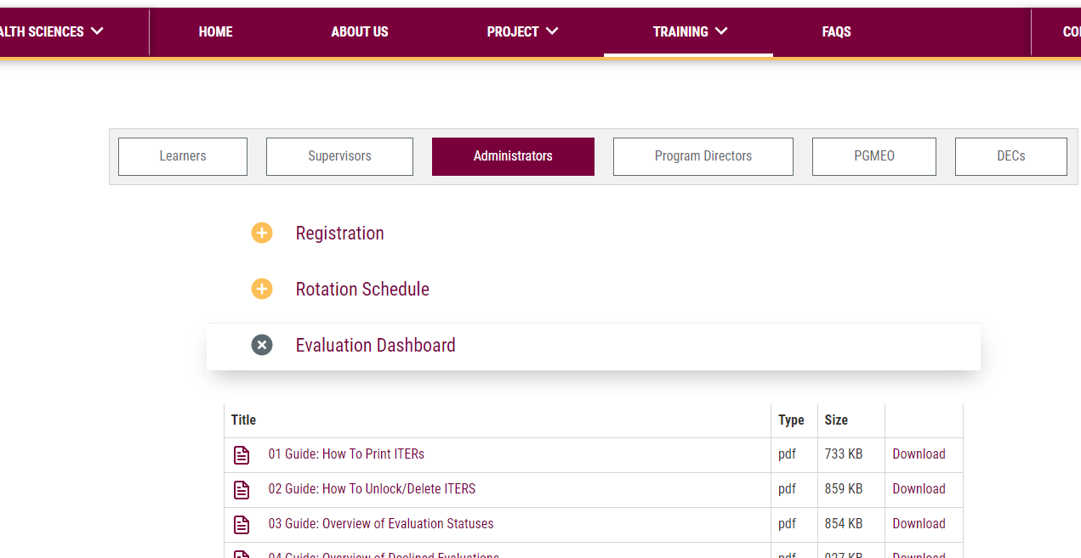
MEDSIS WEBSITE
https://healthsci.mcmaster.ca/medsis/training/pgme
You can find this information as well as more resources on our website under:
TRAINING → PGME → ADMINISTRATORS
JIRA TICKETING SYSTEM
To submit a ticket, please visit medsishelp.mcmaster.ca
User Guide: How to Submit a Ticket

